Slide 1


CAMPAIGN REVIEW
TEEN VAPING AWARENESS CAMPAIGN
City of Jacksonville, FL
August 11, 2021

Slide 2
CAMPAIGN GOAL & OBJECTIVES
ONE PRIMARY GOAL
To “raise awareness regarding the dangers of vaping” among “middle school and high school aged students.”
SUPPORTING OBJECTIVES
DEVELOP a comprehensive marketing plan – the plan should feature digital and non-digital outreach, town halls and peer-to-peer engagement.
AVOID demonizing the vaping industry as a whole – campaign is about the unique vulnerabilities of underage vapers, and the ways that vaping can impact this demographic.
REACH as many Jacksonville residents as possible – strategy and allocation of resources should maximize the reach of the campaign.
TRACK/MEASURE change in underage vaping – utilize available resources to measure the change in awareness, intent and usage.
--------- 13 - 16 YEARS ---------
2

Slide 3





TARGET AUDIENCE
FOCUSING OUR TARGET
Our target age is 11 – 17 years
Kids entering middle-school and rising seniors in high-school have little in common
Sweet spot will be 13 - 16 years (Understanding that Ideas should resonate across ages)
11 YEARS
17 YEARS
Communication should also ensure that children, their parents, educators, and communities develop greater awareness of the harmful products and delivery methods, as well as the health and addiction risks.
13 - 16 YEARS
3

Slide 4
OUR STRATEGY
THE BEST STRATEGIES ARE FOUND WHERE THE PRODUCT’S TRUTH
INTERSECTS WITH THE AUDIENCE’S TRUTH.
Vaping amongst teens is not only illegal, but also dangerous to a young person — physically, emotionally and psychologically.
Vaping makes me feel older than I am. I like that I can hide it from my parents. And everyone says it’s safer than smoking, so I don’t see the big deal.
Underage vaping doesn’t make a teen cool, or rebellious,
or even “grown up” – all it does is rob them of their potential.
4

Slide 5
AUDIENCE INSIGHTS
RESEARCH PROVIDES WARNINGS AND OPPORTUNITIES
The teen and pre-teen market is incredibly valuable to companies
in a host of industries and is consequentially well-studied.
Celebrate independence
Tap into desire for rebellion
Avoid being dogmatic—can be seen as a threat to freedom
Convey brightness, youth and vitality, and social aspiration
Be authentic. (Today’s youth can detect fakery quickly.)
Respect them for who they are.
Be an ally, not an inauthentic imitation.
“If the FDA wants to convince kids to stop vaping, it needs to tap into messaging
that appeals to kids’ sense of rebellion, not fear of health risks.” Vox.com
5

Slide 6
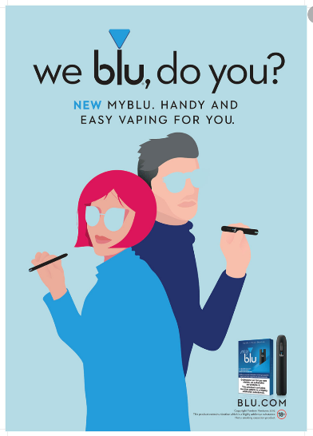
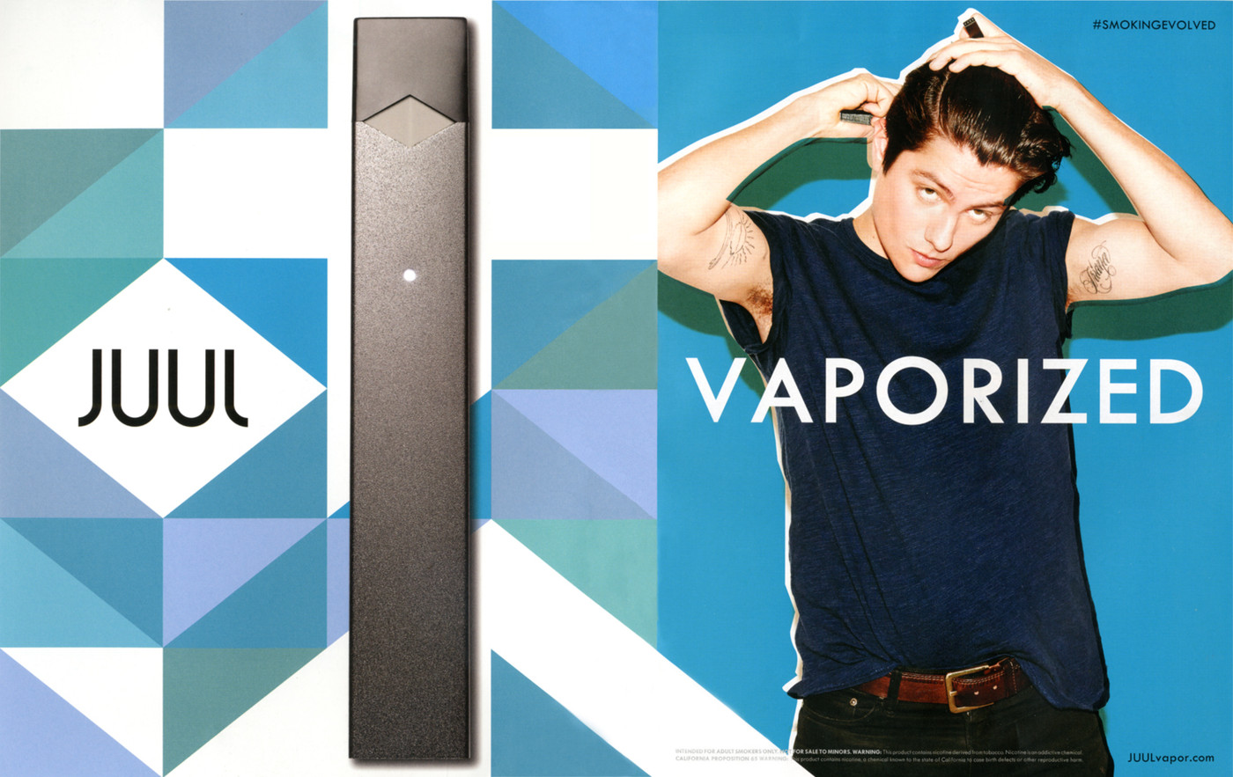
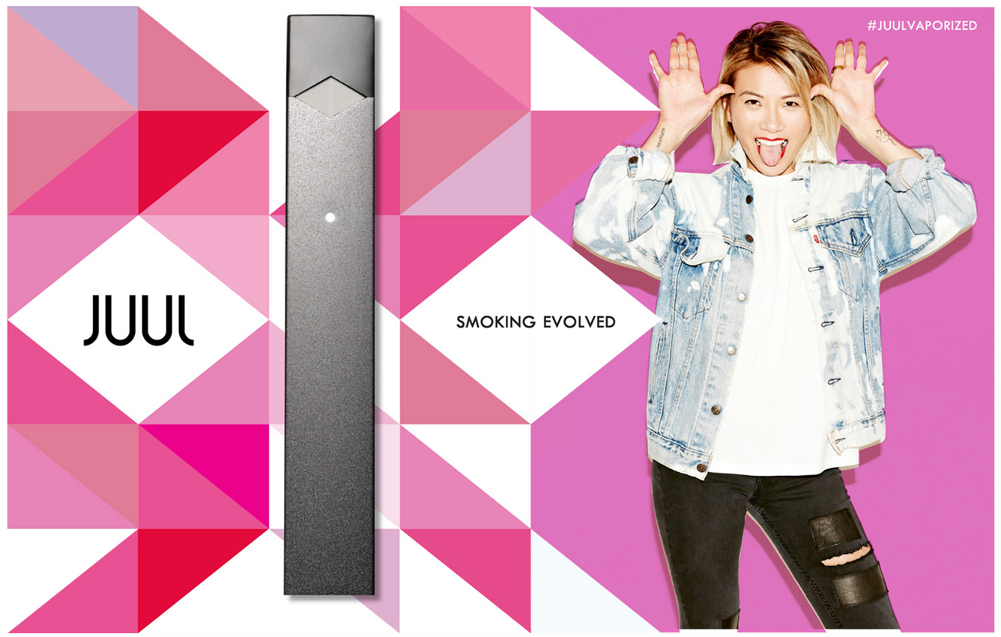
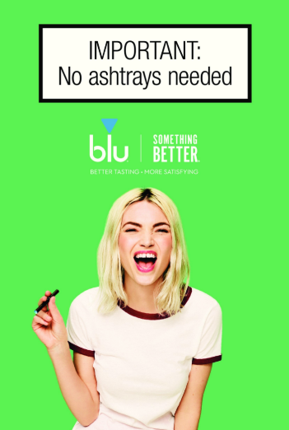
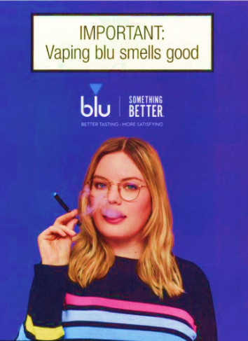
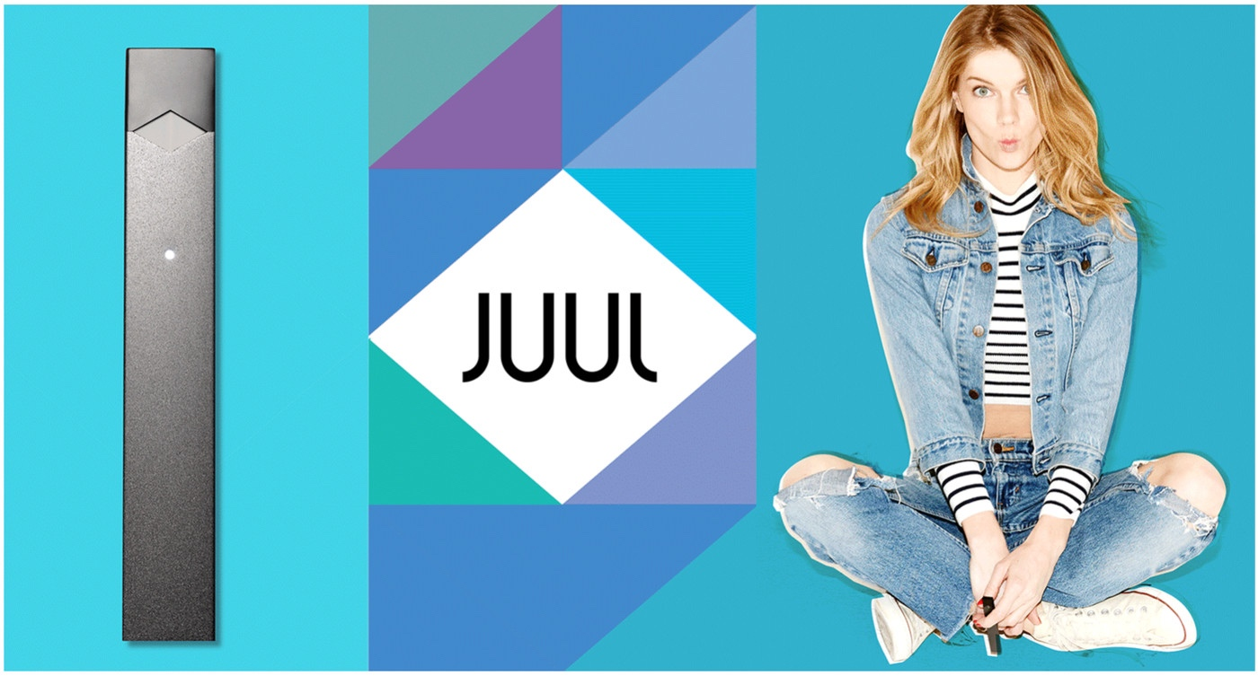
MARKETING: VAPING VS PUBLIC HEALTH
With color, humor and pop culture references, vaping ads are much more effective
at capturing the attention of teens than most public health campaigns.
6

Slide 7
ORIGINAL CAMPAIGN MAP
SOCIAL
DIGITAL
STREAMING
OUTDOOR
CAMPAIGN
LANDING PAGE
LOCAL
PARTNERSHIPS
MEDIA RELATIONS + PR
SURVEYS +
POLLS
VIDEO +
SCHOOLS
PRINT
COLLATERAL
Utilizes audience behavior to inspire contemplation and action
Communications create connections and reinforces messaging.
Drives to the microsite to further educate and motivate change.
7

Slide 8

TURNING UP THE VOLUME
ADULTS
Launch Event
OOH
HIGH-SCHOOL STUDENTS
Digital Ad Buy
SnapChat
MIDDLE-SCHOOL STUDENTS
Social Ad Buy
SnapChat
PR Campaign
Partnership Campaign
Social Ad Buy
Social Ad Buy
YouTube
School Partnerships
Handouts
Community Partners
YouTube
School Partnerships
Community Partners
Handouts
Digital Ad Buy
8

Slide 9
MEASURING OUR RESULTS
PRE-LAUNCH CAMPAIGN SURVEY
Using SurveyMonkey or similar online service to assess attitudes towards vaping and exposure to anti-vaping messaging
2021 NATIONAL YOUTH TOBACCO SURVEY
Useful to identify trends, outliers and to perform basic comparisons
FLORIDA YOUTH TOBACCO SURVEY
Odd year survey – state level data collection only. Useful for comparison
03/2021
07/2021
10/2020
06/2021
09/2021
MID-CAMPAIGN SURVEY
Same basic survey with additional questions regarding campaign awareness
POST-CAMPAIGN SURVEY
Final online awareness assessments regarding attitudes towards vaping, exposure to anti-vaping messaging and campaign awareness
9

Slide 10
THE IMPACT OF COVID-19
- 1 -
- 2 -
- 3 -
Unplanned and unexpected local and national policy and safety issues caused significant delays in awarding the campaign, and in launching it, shrinking the time available to achieve our objectives.
The inability to host in-person meetings, trainings and events – especially at schools – forced us to abandon some fundamental public health communications tactics.
Lockdowns and health safety measures denied us the opportunity to build out our network of local partners and supporters.
Expanding workplace restrictions meant that we were in a race against time to produce the videos and photography we needed for the campaign.
State of emergency declarations and other public health decisions changed the habits and daily behaviors of the local population, pushing us to adjust our media buys and placements.
Media resources were focused on COVID coverage, making it more difficult to place stories about our campaign, hindering our planned PR efforts.
Unplanned and unexpected local and national policy and safety issues
Delayed awarding the campaign and launching it, shrinking the time available to achieve our objectives.
Unable to host in-person meetings, trainings and events, especially at schools
Forced us to abandon some fundamental public health communications tactics.
Lockdowns and health
safety measures
Denied us the opportunity to build out our network of local partners and supporters.
- 4 -
- 5 -
- 6 -
Expanding workplace restrictions
Put us in a race against time to produce the videos and photography we needed for the campaign.
State of emergency declarations and other public health decisions
Changed the habits and daily behaviors of the local population, pushing us to adjust our media buys and placements.
Media resources were focused on COVID coverage
Made it more difficult
to place stories about our campaign, hindering our planned PR efforts.
--------- 13 - 16 YEARS ---------
10

Slide 11
REALITY BITES
SOCIAL
DIGITAL
STREAMING
OUTDOOR
CAMPAIGN
LANDING PAGE
LOCAL
PARTNERSHIPS
MEDIA RELATIONS + PR
SURVEYS +
POLLS
VIDEO +
SCHOOLS
PRINT
COLLATERAL
Utilizes audience behavior to inspire contemplation and action
Communications create connections and reinforces messaging.
Drives to the microsite to further educate and motivate change.
11

Slide 12
REALITY BITES
ADULTS
Launch Event
OOH
HIGH-SCHOOL STUDENTS
Digital Ad Buy
SnapChat
MIDDLE-SCHOOL STUDENTS
Social Ad Buy
SnapChat
PR Campaign
Partnership Campaign
Social Ad Buy
Social Ad Buy
YouTube
School Partnerships
Handouts
Community Partners
YouTube
School Partnerships
Community Partners
Handouts
Digital Ad Buy
12

Slide 13
REALITY BITES
PRE-LAUNCH CAMPAIGN SURVEY
Using SurveyMonkey or similar online service to assess attitudes towards vaping and exposure to anti-vaping messaging
2021 NATIONAL YOUTH TOBACCO SURVEY
Useful to identify trends, outliers and to perform basic comparisons
FLORIDA YOUTH TOBACCO SURVEY
Odd year survey – state level data collection only. Useful for comparison
03/2021
07/2021
06/2021
09/2021
10/2020
01/2021
MID-CAMPAIGN SURVEY
Same basic survey with additional questions regarding campaign awareness
POST-CAMPAIGN SURVEY
Final online awareness assessments regarding attitudes towards vaping, exposure to anti-vaping messaging and campaign awareness
13

Slide 14

ACHIEVING SUCCESS
Despite the impact of COVID-19, and the need to radically adjust our campaign plan in response to the ongoing and evolving public health crisis,
Jacksonville’s first Anti Teen Vaping Awareness Campaign
met and exceeded the City’s stated goal,
and along the way established a new benchmark for public health campaigns of this type.
--------- 13 - 16 YEARS ---------
14

Slide 15





ACHIEVING SUCCESS
The teen-focused digital advertising campaign was seen by tens of thousands of middle-school and high-school students between January and July of 2021.
More than 12,000 of those students swiped, clicked and engaged with our content, easily outperforming industry averages and expectations.
The videos shared through the companion, adult-focused, Facebook campaign were watched all the way through over 65,000 times.
The campaign’s content hub, on CoJ.net, averaged 65 visits a day during the core advertising period.
Average time spent on the campaign home page was 135% of the 2020 average for all websites, and close to 150% of the average time across all consumer industries.
--------- 13 - 16 YEARS ---------
15

Slide 16



MEASURING REACH – SOCIAL MEDIA
Video Ads on Facebook & Instagram:
Facebook and Instagram Videos generated 171,922 impressions
People on Facebook & Instagram watched the complete video 65,062 times
People on Facebook & Instagram watched at least half of the video 143,485 times
More than 41% of Videos served to people on Facebook & Instagram were watched to completion
Facebook & Instagram Videos achieved a CTR of 0.67%, 6X the Benchmark rate of 0.11%
Top 3 Months were February with 0.80% CTR, and March and May tied with 0.61%. These months accounted for 68% of all Click Thrus.
Video & Display Ads on Snapchat:
Snapchat Video & Display Ads generated 1,193,959 impressions
Total Snapchat campaign ‘Swipe Up Rate’ (SUR) was 0.37%
On average, 40% of all impressions served had User Engagement
16

Slide 17
MEASURING REACH – ONLINE ADVERTISING
Online Video and Display Ads together received 1,588,311 impressions
More than 47% of Video Ads were watched to completion
The three Video Ads achieved a CTR of 0.99%
The three Video Ads generated 374,333 Impressions, accounting for 50% of all Click Thrus.
Three types of Video Ads were geo-targeted exclusively to Duval County:
AD TYPE | BENCHMARK PERFORMANCE | CAMPAIGN PERFORMANCE | COMPARATIVE CTR (CLICK THRU RATE)
PRE-ROLL AUDIENCE (Audience defined by age, behavior, household type, etc.) | 0.57% CTR | 0.84% | 1.5X Benchmark CTR
PRE-ROLL RON (Wider selection of sites defined by location of user) | 0.57% CTR | 1.44% | 2.5X Benchmark CTR
RUN OF NETWORK (ad plays on any site across ad network) | 0.05% CTR | 0.31% | 6X Benchmark CTR
--------- 13 - 16 YEARS ---------
17

Slide 18
MEASURING CHANGE
At the end of the campaign, fewer students believe that vaping is ‘definitely’ or ‘probably’ harmless. (approx. 3% shift)
At the end of the campaign, more students believe that vaping is ‘definitely’ or ‘probably’ harmful. (approx. 2% shift)
At the end of the campaign, more students know that ‘all’ or ‘most’ vape juice contains nicotine. (approx. 20% shift)
18

Slide 19
MEASURING CHANGE – VAPINGGETSUGLY.COM
Website Metrics:
In six months, the campaign website saw more than 10,000 page views
Average time spent on each page was 66.86 seconds
Top 3 Weeks for visitors were January 17-23 (the week of the launch) with 709 pageviews, January 24-30 with 827 pageviews, and January 31-February 6 with 905 pageviews
Bottom 3 weeks for visitors were all after the end of the primary advertising campaign, June 13-19 with 31 page views, June 20-26 with 29 pageviews, and June 27-July 6 with 32 pageviews.
In the weeks surrounding Spring Break, we pulled our Online, Facebook, Instagram and Snapchat ads. As we prepped for Campaign Phase 2, the only ads running were on www.Jacksonville.com and in the Florida Times Union.
During that period, pageviews dropped to an average of 248 per week versus an average of 520 pageviews per week when our Online, Facebook, Instagram and Snapchats ads were running.
--------- 13 - 16 YEARS ---------
19

Slide 20
NEXT STEPS – VAPINGGETSUGLY.COM
Build On Success And Make It Stick:
We have made significant progress in the course of our initial six month campaign. To capitalize upon that achievement, to make sure our message sticks, and to generate lasting behavioral change, Public Health Campaign best practices recommend a repeat performance.
Renewing the campaign for a second year, would allow us deploy the powerful in-person and on-site tactics we were unable to deliver in Year One.
Our strong connections with local organizations were underutilized, as a result of COVID restrictions. In Year Two, that partnership plan could significantly extend the reach and the impact of our campaign.
As a result of having so many assets already developed, production costs are kept to a minimum, allowing more of the budget to be deployed for campaign execution.
Renewing the campaign illustrates a real commitment to the issue at hand, and allows us to add new elements, including the ability to educate teachers and other key adult mentors.
--------- 13 - 16 YEARS ---------
20

